Slide 1
CVCORP TURF
__BREAK A SWEAT,CREACK A SMILE__

Slide 2
CONTENTS
REGISTER/SIGNUP
LOGIN
CHOOSE THE SPORT
PAYMENT

Slide 3
ABSTRACT
Turf games such as cricket, table tennis and volleyball are gaining popularity among enthusiasts.
A streamlined signup and login process is essential for an efficient ticket booking system.
An account setup can facilitate quicker transactions and enhance security during the booking process
They can choose the game/sport what they want to play and they can book their slot by the time and date.

Slide 4

SPORTS

Slide 5
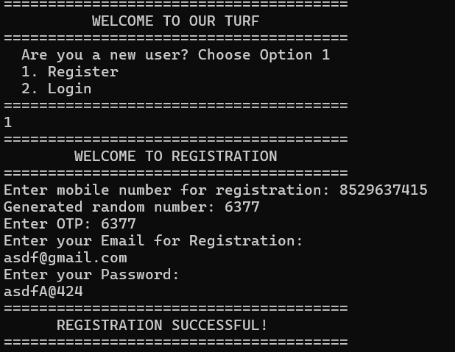
Sign up/register
The signup process typically requires basic information such as name, email, and phone number.
Users may need to create a secure password to safeguard their account information.
A confirmation email is often sent to verify the registered email address and complete the signup.

Slide 6
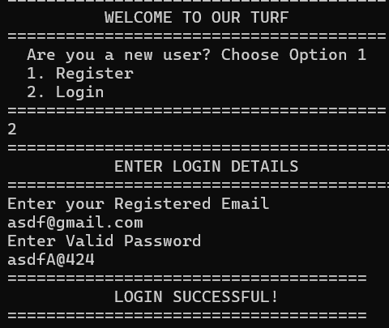
Login
Returning users can access their accounts using their registered email and password.
A "forgot password" option is crucial for helping users regain access to their accounts securely.
A seamless login experience encourages users to return for future bookings and events.

Slide 7
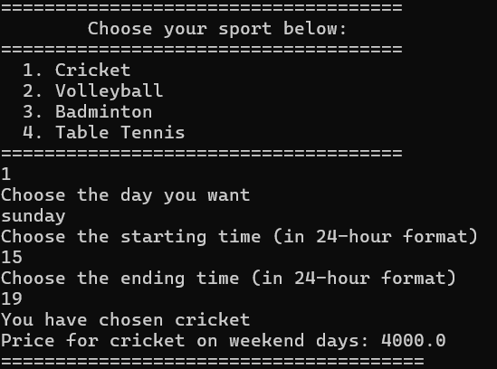
Choose the sport
Users can browse available turf games based on their interests, such as cricket
or volleyball.
Once a game is selected, users can specify the number of hours to play their selected sport.
After that they will get the payment details according to their time and day.

Slide 8
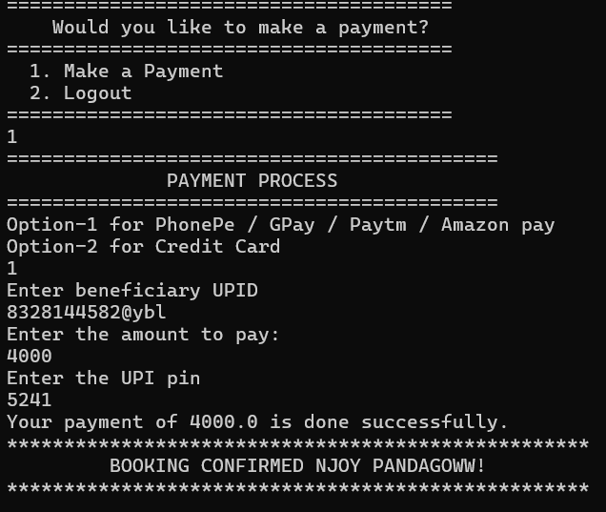
payment
A clear overview of total costs, including any applicable fees, is essential for transparency.
Users should receive immediate confirmation of their booking through email or SMS notifications.

Slide 9


